Slide 1
Exposure Java 2013
APCS Edition
Chapter 8 Slides
Focus on OOP, Encapsulation
PowerPoint Presentation
created by:
Mr. John L. M. Schram
and Mr. Leon Schram
Authors of Exposure Java

Slide 2
Section 8.1
Introduction
Notes:
Object Oriented Programming will not be casually mentioned in this chapter. OOP is the front-center topic right now and the intention is to cover some very important OOP ground. Right now you have a variety of basic Java tools under your belt and you are ready to learn about this very fascinating, modern approach to programming.
Now keep in mind that the single most important goal for any program is reliability. Speed is great, user-friendly is requested, cheap is desirable, but nothing matters if the software does not work properly.
First and foremost a program, or program module, must perform its intended task correctly, the first time, the last time and every time in between.
an organized approach to programming. In particular, by dividing a program into manageable blocks, and concentrating on completing and testing the smaller blocks.
Names like structured programming, modular programming, procedural programming, became important buzzwords and programming tools.
Keep in mind that early programs only produced text output. You should know text output, because many program examples have produced text output so far. With the arrival of the Graphical User Interface (GUI) the world of programming changed very dramatically, and program complexity has been growing exponentially ever since.
A new style of programming came on the scene slowly, at first, but rapidly gained momentum and brought about a whole new way of thinking about programming. Now it matters little if impressive vocabulary is tossed around.
The bottom line is still reliability, and as you gain more computer science knowledge you will clearly see how Object Oriented Programming in general and Java in particular do an outstanding job to make programs more reliable.

Slide 3
Objects, Variables & Methods
Java encapsulates data and action modules that access the data in one container, called an object.
Object members that perform some task are called methods.
Object members that store data are called attributes.
Notes:
three corner stones of OOP are encapsulation, class interaction, and polymorphism.
Some brief introduction to encapsulation happened earlier
We will continue to explore encapsulation and pick up the pace dramatically.
Programs involve data and the modules that access and process the data.
The problem in the past has been that the data and the modules processing the data, called procedures and functions, were separated.
This approach caused serious reliability problems. As programs grew in size so did the likelihood that some procedure or function accessed data unintentionally and made unwanted and often disastrous changes to data values.
A new style of thinking helped prevent these kinds of problems. This style of thinking revolves around objects. Objects store data and objects also store the modules - called methods in Java - which process the data.
So far the object seems no different from programs that combine data storage and procedures that process the stored data. What makes objects unique is that every object has its own set of methods, which are unique to the object and the object stores the data that is appropriate for the object.
Furthermore, special precautions are designed into the object to insure that data is properly initialized and accessed. As a matter of fact, a proper object will not allow anything outside the object to access its data directly for fear of potential problems. A well-designed object carries its own methods that safely handle the object data.
So what does this all mean? This means you have encapsulation, which is a fancy, but very appropriate word. The data and the methods that act upon the data are all contained in one package or capsule, called an object. Multiple objects can be created for multiple purposes. You can also think of this package as a capsule, a container, and hence the word encapsulation.
Now we must get clear on the vocabulary used with objects. You have heard talk about actions, subroutines, processes, procedures, functions, and methods. All these words have been used intentionally, because you will probably find every term used somewhere in computer science. Each one of these words implies some program module that performs a task, frequently involving data, but not always. However, some task is always involved that must be accomplished.
FORTRAN and BASIC started with subroutines
Pascal followed by having both procedures and functions
C++ wanted every module to be called a function
Currently we use the word method, and Java error messages will be using that terminology.
From here on, method will be used. Keep the following object vocabulary in mind.

Slide 4
Section 8.2
Creating a
New Class
Notes:
Java uses many containers. There are class, methods loop control structure containers and selection structure containers. Containers have a heading followed by a set of curly braces { } , which indicate the start and the end of the container.
This chapter is the first focus on Object Orient Programming (OOP) and this first focus is on encapsulation. The introduction stated that the goal of encapsulation is to encapsulate data and all the methods that access the data in the same container or capsule. This capsule in Java is officially called a class.
It has been stated in earlier chapters that a class is a toolkit and a method is a tool. Now it is does not matter if a class is called a container, a capsule, or a toolkit, because the creation of a class will need to start by first creating a container, a capsule or a toolkit. A case study follows that will start very simply and steadily increase in complexity as the class become more and more complete.
There are two case studies formats. The first type presents a completed program. An execution of the completed program is demonstrated followed by an investigation of every component in the program. Explanations are given about the design of the program and the decisions that were made to arrive at a final solution that is presented.

Slide 5

The CardDeck Case Study
CardDeck Methods | CardDeck Data
Initialize Deck | # of Decks
Shuffle Deck | # of Players
Deal Cards From Deck | # of Cards Dealt
Count Leftover Cards | # of Cards Left
You could probably think of many more methods and attributes.
Notes:
The second style of case study starts with a minimal program. Step after small step the program grows and an explanation is given with each small improvement along the way. There are good arguments for each style of case study and those arguments are not significant right now. The CardDeck case study that follows will use the second case study style.

Slide 6
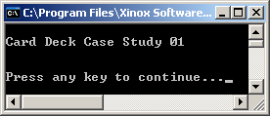
// Java0801.java
// CardDeck Case Study #01
// This shows a minimal class declaration.
// This class has no practical value, but it compiles and executes.
public class Java0801
{
public static void main(String args[])
{
System.out.println("\nCard Deck Case Study 01\n");
CardDeck d = new CardDeck();
System.out.println();
}
}
class CardDeck
{
}
Notes:
Program Java0801.java, in figure 8.1, brings little excitement, but it sets the stage. The main method instantiates a CardDeck object, but nothing can be done with this object. However, the program compiles and creates a simple skeleton for the start of our case study.
Note how the CardDeck class is not declared public. Only one class can be declared public and that is the class with the same name as the file name. Proper program design suggests that each class resides in its own file. In this textbook, and especially with case studies, multiple classes are frequently combined in one file for clarity. Our main focus is on the development of the CardDeck class, but this growing class needs to be tested at each stage by an outside class that creates an object of the CardDeck class.

Slide 7
Section 8.3
Restricting
Attribute Access
Notes:
What type of data needs to be stored in the CardDeck class? For this chapter it does not matter since it is not necessary to make the list complete. The purpose of the case study is to present an introduction to Object Oriented Programming, and specifically, the process of encapsulation. It is not the goal to make a fully functional CardDeck class, but the hope is that the information presented will make it possible to create such a class, if needed.

Slide 8
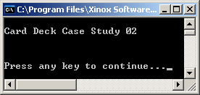

// Java0802.java
// CardDeck Case Study #02
// Variables, called attributes or data fields, are added to the <CardDeck> class.
public class Java0802
{
public static void main(String args[])
{
System.out.println("\nCard Deck Case Study 02\n");
System.out.println();
CardDeck d = new CardDeck();
System.out.println();
}
}
class CardDeck
{
String cardGame; // name of the card game
int numDecks; // number of decks in a game
int numplayers; // number of players in a game
int cardsLeft; // number of cards left in the deck(s)
}
Notes:
. For now there will only be four attributes. The first attribute, cardGame, stores the name of the card game. Then the numDecks data field stores the number of card decks, numPlayers stores the number of players in the game, and cardsLeft stores the number of cards left in the deck(s). Program Java0802.java in figure 8.2 adds these variables, but nothing is done yet besides placing the variables in the correct location. Right now there is not any type of data access at this stage.

Slide 9
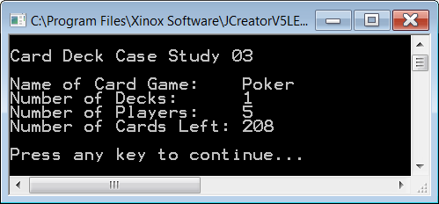

// Java0803.java
// CardDeck Case Study #03
// <CardDeck> variables are accessed directly by the <main> method.
// This program violates encapsulation, even though it compiles, and executes.
// This approach greatly compromises program reliability.
public class Java0803
{
public static void main(String args[])
{
System.out.println("\nCard Deck Case Study 03\n");
CardDeck d = new CardDeck();
d.cardGame = "Poker";
d.numDecks = 1;
d.numPlayers = 5;
d.cardsLeft = 208;
System.out.println("Name of Card Game: " + d.cardGame);
System.out.println("Number of Decks: " + d.numDecks);
System.out.println("Number of Players: " + d.numPlayers);
System.out.println("Number of Cards Left: " + d.cardsLeft);
System.out.println();
}
}
class CardDeck
{
String cardGame;
int numDecks;
int numPlayers;
int cardsLeft;
}
Notes:
Simple data types store single values. This may a single integer, a single character, a single decimal number or a single boolean. It is not necessary to indicate which member of the variable is being used. There is only one member. It is not an issue. You learned with the Math class that both the class identifier and the method or field identifier must the used, like Math.sqrt(100) or Math.PI. If object methods are members of a class then an object must be constructed and the object name is used with the method identifier
Using this same data access approach this means that if d is an object of the CardDeck class, and numDecks is a field identifier in the class, then you would use syntax like d.numDecks to access a field inside the object.
This is precisely what is done by program Java0803.java in figure 8.3. First, values are assigned to the four CardDeck variables and then those values are displayed. You will find that the program compiles just nicely and it also gives the desired, correct output.

Slide 10

// Java0804.java
// CardDeck Case Study #04
// All the variables in the <CardDeck> class are
// now declared as private access.
// This prevents improper, public access to the
// data variables.
public class Java0804
{
public static void main(String args[])
{
System.out.println("\nCard Deck Case Study 04\n");
CardDeck d = new CardDeck();
d.cardGame = "Poker";
d.numDecks = 4;
d.numPlayers = 5;
d.cardsLeft = 208;
System.out.println("Name of Card Game: " + d.cardGame);
System.out.println("Number of Decks: " + d.numDecks);
System.out.println("Number of Players: " + d.numPlayers);
System.out.println("Number of Cards Left: " + d.cardsLeft);
System.out.println();
}
}
class CardDeck
{
private String cardGame;
private int numDecks;
private int numPlayers;
private int cardsLeft;
}
Notes:
Compiling and nice output are lovely, but it is not sufficient. We committed a serious offense and the OOP Police will probably give us several tickets. The essence of encapsulation is to package the data and the methods that access the data in one container. However, it is not sufficient to package data and methods together; you also need to insure that only a select number of methods can access the data.

Slide 11
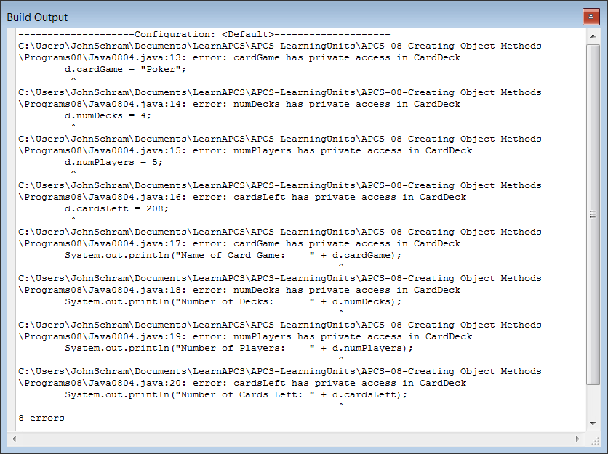
Notes:
Accessing the data directly, from outside the class, is a very serious crime in OOP Land. This type of access can create serious unwanted data access and this will be more likely as programs are larger. The next stage, shown by program Java0804.java, in figure 8.4, shows how to insure against that problem by declaring the data attributes as private.

Slide 12
private & public Members
Members in a class need to be declared as private or public.
private members cannot be accessed by any program segments outside the class.
Data attributes of a class usually need to be declared private.
public members of a class can be accessed by program segments outside the class.
Notes:
The next section will explain how data can be properly accessed. There may be a few exceptions, but in most cases declare attributes private. You have seen some exception, such as Math.PI and Math.E and in both cases the data fields store constant values that are never meant to change.

Slide 13
“How does using private give you any security when you can just change it back to public?”
Think of any video game that you
have ever purchased.
Do you ever see the source code?
Only the programmers have the source code.
What they sell to users is an executable file.
Notes:
Consider a typical bank. The bank has a lobby that is open to the public. From the lobby, customers can go to tellers to make deposits, withdrawals and loan payments. There are also lobby offices where bank officers take loan applications, handle investments and handle customer concerns. Every area that is mentioned is open to the public.
The bank also has areas that are open only to the bank employees. These private areas include the teller area, which contains the cash drawers and containers that store all the daily check deposits. There is the very private bank vault where large deposits of cash are stored and there is also the private bathroom that is meant for bank employees only.
These physical private and public areas may seem a good analogy to the private and public access that is used with the design of a new class. The bank has more and that is not physical, but electronic and it also involves levels of access. Every bank has a web site. The home page of the bank is very public and draws attention to many services available to the existing customer or potentially new customer. At this area different bank accounts are explained, as well as available loans and credit cards.
Existing customers can go further and enter a private access personal account. Once proper user id and password are entered, a customer can see bank account transactions, pay bills, make transfers and apply for a loan or credit card. Perhaps it is in this area that we truly see the virtue of private access. All bank accounts have private access. It does not make any sense to let the general public have access to all the many customer bank accounts.

Slide 14
Section 8.4
Get & Set
Methods
Notes:
If private access is restricted then it has no practical value. The whole point in combining public local methods with private local attributes is to control data access. In the case of a bank the entry of a UserID and a Password gains access. Frequently, access is even stricter to protect possible fraud and customers are shown a special picture or phrase that insures a customer that the proper bank web site is in fact being used.
Access to a customer's account is not limited to the customer. A teller can look at the account to determine if the balance is large enough for the requested withdrawal. A bank officer uses access to both the private account of the bank itself and a customer to transfer money from the bank account to the customer account after a loan is approved. In every example stated you see the private attribute, a bank account, and an accessing method, like the bank teller or bank officer, which handles the private account in a proper manner to insure reliability and proper privacy.

Slide 15
// Java0805.java
// CardDeck Case Study #05
// The <CardDeck> class now has four "get" methods to return
// the data values of <CardDeck> objects.
// Note that Java assigns initial values to object data.
public class Java0805
{
public static void main(String args[])
{
System.out.println("\nCard Deck Case Study 05\n");
CardDeck d = new CardDeck();
System.out.println("Name of Card Game: " + d.getGame());
System.out.println("Number of Decks: " + d.getDecks());
System.out.println("Number of Players: " + d.getPlayers());
System.out.println("Number of Cards Left: " + d.getCards());
System.out.println();
}
}
Notes:
Program Java0805.java, in figure 8.5 , shows the next stage of the CardDeck class, which will include four methods to return the values of the four data attributes. These four methods get information for the some program segment outside the class. By convention such methods are called "get methods" and frequently get is part of the method identifier, as you see in method getDecks. Do not expect some clever program code that insures proper data access as was explained for a customer's bank account. The program examples in this chapter are concerned with explaining the reasoning for encapsulation and how to create proper classes.

Slide 16
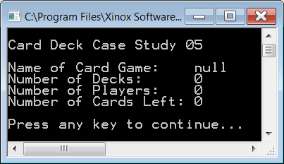
class CardDeck
{
private String cardGame;
private int numDecks;
private int numPlayers;
private int cardsLeft;
public String getGame() { return cardGame; }
public int getDecks() { return numDecks; }
public int getPlayers() { return numPlayers; }
public int getCards() { return cardsLeft; }
}
Notes:
There is something curious about stage 06. There are four methods used to return the values stored by the CardDeck object, but there is no evidence that any values were ever stored to any of these four data fields. This is intentional. It shows that Java assigns default values when a new object is instantiated. Any of the int variables is assigned value 0.
Zero or 0 makes perfect sense, but what is null for cardGame? A confession must be made here. Java has an interesting data type, called String. It is possible to create String variables and use String variables as if they were simple data types just like int and boolean. The reality is that String is a class, complete with its own set of methods. null is not the same thing as zero. Zero is a value. We state that water freezes at 0 degrees Celsius. On the other hand, null means no value. Any object that is not assigned an initial value will return value null.

Slide 17
// Java0806.java
// CardDeck Case Study #06
// The <CardDeck> class adds four "set" methods
// to alter the data attributes of <CardDeck> objects.
public class Java0806
{
public static void main(String args[])
{
System.out.println("\nCard Deck Case Study 06\n");
CardDeck d = new CardDeck();
d.setGame("Bridge");
d.setDecks(1);
d.setPlayers(4);
d.setCards(52);
System.out.println("Name of Card Game: " + d.getGame());
System.out.println("Number of Decks: " + d.getDecks());
System.out.println("Number of Players: " + d.getPlayers());
System.out.println("Number of Cards Left: " + d.getCards());
}
}
Notes:
Altering the values of object instance variables is the job of set methods. These methods are parameter methods that normally change the value of a single attribute. Like the get methods, set methods frequently use the word set in the method identifier like, setDecks. Program Java0806.java, in figure 8.6, shows the improved CardDeck class with three segments. There are data attributes, get methods and set methods.
By convention many programmers use complete, self-commenting identifiers for the data fields of the class and then use abbreviations of those names as the formal parameters in the headings of the methods.

Slide 18
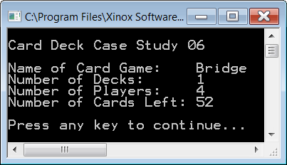
class CardDeck
{
// Data attributes
private String cardGame;
private int numDecks;
private int numPlayers;
private int cardsLeft;
// Get return Methods
public String getGame() { return cardGame; }
public int getDecks() { return numDecks; }
public int getPlayers() { return numPlayers; }
public int getCards() { return cardsLeft; }
// Set void Methods
public void setGame(String cG) { cardGame = cG; }
public void setDecks(int nD) { numDecks = nD; }
public void setPlayers(int nP) { numPlayers = nP; }
public void setCards(int cL) { cardsLeft = cL; }
}
Notes:
You will also note that the earlier get methods are shown in a compact style where each method is written on one line. This style saves space and it is often done for short methods that only have one program statement. It was not done for set methods, because they are emphasized in this section.

Slide 19
Section 8.5
Constructor
Methods
Notes:
It is easier to demonstrate the creation of get methods and set methods, but in the real world of designing classes and writing program, you need to create the constructor methods after the data is selected. The job of the constructor is to initialize the attributes of an object.

Slide 20
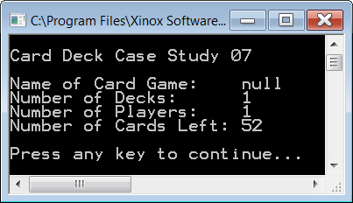
// Java0807.java
// CardDeck Case Study #07
// This <CardDeck> class uses a constructor to initialize variables
// during the instantiation of a new <CardDeck> object.
// This is an example of increasing reliability by an automatic constructor call.
public class Java0807
{
public static void main(String args[])
{
System.out.println("\nCard Deck Case Study 07\n");
CardDeck d = new CardDeck();
System.out.println("Name of Card Game: " + d.getGame());
System.out.println("Number of Decks: " + d.getDecks());
System.out.println("Number of Players: " + d.getPlayers());
System.out.println("Number of Cards Left: " + d.getCards());
System.out.println();
}
}
Notes:
The constructor is automatically called by the new operator and increases reliability by assigning correct starting values to the data. Program Java0807.java, in figure 8.07, shows the improvement created by adding a constructor to the program.

Slide 21
class CardDeck
{
private String cardGame;
private int numDecks;
private int numPlayers;
private int cardsLeft;
// Constructor
public CardDeck()
{
cardGame = null;
numDecks = 1;
numPlayers = 1;
cardsLeft = 52;
}
public String getGame() { return cardGame; }
public int getDecks() { return numDecks; }
public int getPlayers() { return numPlayers; }
public int getCards() { return cardsLeft; }
public void setGame(String cG) { cardGame = cG; }
public void setDecks(int nD) { numDecks = nD; }
public void setPlayers(int nP) { numPlayers = nP; }
public void setCards(int cL) { cardsLeft = cL; }
}
Notes:
It is easy to think that constructors exist for the purpose of initializing object data. Constructors certainly fill that role, but it is not the only role. In more general terms the constructor prepares the new object to fulfill its duty as best as possible. This starts with correct initial values, but there is more. Think card games now. Is it not very important that a deck is shuffled before any game begins? Any computer game that involves cards needs some means to shuffle the decks before they are used.

Slide 22
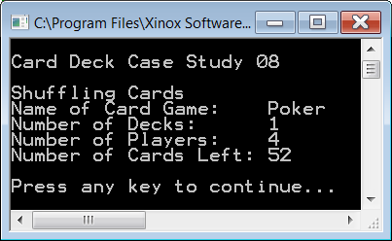
// Java0808.java
// CardDeck Case Study #08
// This program adds the <shuffleCards> method, which is a <private>
// helper method used by the <CardDeck> constructor.
public class Java0808
{
public static void main(String args[])
{
System.out.println("\nCard Deck Case Study 08\n");
CardDeck d = new CardDeck();
System.out.println("Name of Card Game: " + d.getGame());
System.out.println("Number of Decks: " + d.getDecks());
System.out.println("Number of Players: " + d.getPlayers());
System.out.println("Number of Cards Left: " + d.getCards());
System.out.println();
}
}
Notes:
Shuffling seems like a good candidate for a new method, and it is also a terrific candidate for improving the constructor. The constructor is called automatically, and it is capable of calling other methods in the class. By including a call to a shuffling method, the constructor insures that any newly constructed CardDeck object is shuffled and ready to go.

Slide 23

class CardDeck
{
private String cardGame;
private int numDecks;
private int numPlayers;
private int cardsLeft;
public CardDeck()
{
cardGame = "Poker";
numDecks = 1;
numPlayers = 4;
cardsLeft = 52;
shuffleCards();
}
private void shuffleCards() { System.out.println("Shuffling Cards"); }
public String getGame() { return cardGame; }
public int getDecks() { return numDecks; }
public int getPlayers() { return numPlayers; }
public int getCards() { return cardsLeft; }
public void setGame(String cG) { cardGame = cG; }
public void setDecks(int nD) { numDecks = nD; }
public void setPlayers(int nP) { numPlayers = nP; }
public void setCards(int cL) { cardsLeft = cL; }
}
Notes:
The shuffling method will also be used to illustrate another point. So far you have seen that all the CardDeck data variables are declared private, and all the CardDeck methods are declared public. It is easy to draw the conclusion that data is always private and methods are always public. It is true that most data is declared private and most of the methods are declared public, but it is not required as you will see in the next program.
Classes include helper methods. Helper methods are not meant to perform a procedure that is used by some other class. A helper method exists for the purpose of assisting some other method in the same class. The shuffling method is one example of such a helper method. Your lab assignment has an excellent example of a method that is only needed within the class. For the lab assignment you will work with a Rational class. The purpose of the rational class is to store and manipulate rational numbers. Rational numbers include whole numbers and fractions. One important capability of the Rational class is the ability to reduce fractions, and this can be done with the Greatest Common Factor (GCF). The private, helper method computeGCF, assists the reduce method, but it is not needed anywhere else. Program Java0808.java, in figure 8.8 demonstrates the use of a private method in a class.

Slide 24
// Java0809.java
// CardDeck Case Study #09
// A second, overloaded constructor, method is added to the program.
// It is now possible to specify card deck details during instantiation.
public class Java0809
{
public static void main(String args[])
{
System.out.println("\nCard Deck Case Study 09\n");
CardDeck d1 = new CardDeck();
CardDeck d2 = new CardDeck("BlackJack",4,5);
System.out.println();
System.out.println("Name of Card Game: " + d1.getGame());
System.out.println("Number of Decks: " + d1.getDecks());
System.out.println("Number of Players: " + d1.getPlayers());
System.out.println("Number of Cards Left: " + d1.getCards());
System.out.println();
System.out.println("Name of Card Game: " + d2.getGame());
System.out.println("Number of Decks: " + d2.getDecks());
System.out.println("Number of Players: " + d2.getPlayers());
System.out.println("Number of Cards Left " + d2.getCards());
System.out.println();
}
}
Notes:
Every CardDeck object starts its life the same boring way. No card game is decided and then you get 1 Deck, 1 player and 52 CardsLeft. There are many card games with more than one player and there are also card games with more than one deck in the game. You have seen overloaded methods before and this is a situation where overloaded methods are very useful. It is allowed, and strongly encouraged, to create multiple constructors in a class. You have a default constructor, which is good when no parameters are specified for the new object.

Slide 25

class CardDeck
{
private String cardGame;
private int numDecks;
private int numPlayers;
private int cardsLeft;
public CardDeck()
{
System.out.println("Default Constructor");
cardGame = "Poker";
numDecks = 1;
numPlayers = 4;
cardsLeft = 52;
shuffleCards();
}
public CardDeck(String cG, int nD, int nP)
{
System.out.println("Overloaded Constructor");
cardGame = cG;
numDecks = nD;
numPlayers = nP;
cardsLeft = nD * 52;
shuffleCards();
}
private void shuffleCards() { System.out.println("Shuffling Cards"); }
// CardDeck get and set methods will no longer be shown.
Notes:
After the default constructor you can declare extra constructors for a variety of different situations. In our case it will create a CardDeck object with a specified number of numDecks and numPlayers. cardsLeft will not need to be specified because that value is computed as a function of the value of numDecks. Program Java0809.java, in figure 8.9, shows the two constructors in one class.

Slide 26
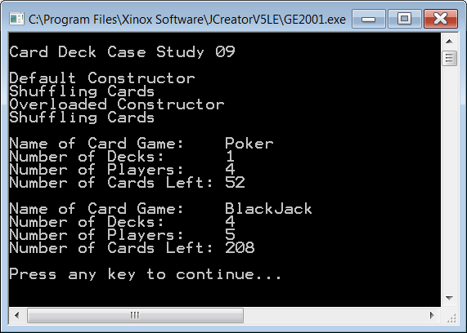
Output for
Program
Java0809.java

Slide 27

Instantiation & Construction
A class is a template that can form many objects.
An object is a single variable instance of a class.
Objects are sometimes called instances.
An object is created with the new operator.
The creation of a new object is called:
instantiation of an object
construction of an object
The special method that is called during the instantiation of a new object is the constructor.

Slide 28





Constructor Notes
Constructors are methods, which are called during the
instantiation of an object with the new operator.
The primary purpose of a constructor is to
initialize all the attributes of newly created object.
Constructors have the same identifier as the class.
Constructors are neither void methods nor are they
return methods. They are simply constructors.
Constructors are always declared public.
Constructors can be overloaded methods.
The method identifier can be the same, but the method
signature (which is the parameter list) must be different.
A constructor with no parameters
is called a default constructor.

Slide 29
Section 8.6
The Cube
Case Study
Notes:
You will be pleased to know that this chapter has a second case study. The intention is that you have a solid OOP foundation in the area of encapsulation when you leave this chapter. The second case study involves manipulation of a cube. A cube is a three-dimensional object and it may be useful to have a special class to assist with some graphics programs that require displaying cubes.

Slide 30

The Cube Case Study
Cube Methods | Cube Data
Draw Cube | x Coordinate
Erase Cube | y Coordinate
Move Cube | size

Slide 31
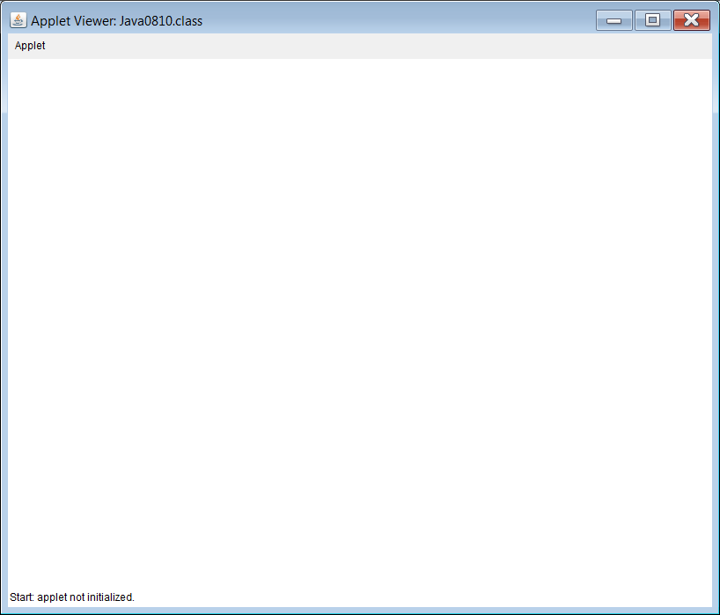
// Java0810.java
// Cube Casestudy #1
// Stage #1 presents a <Cube> class with a default constructor.
// This program does not display a cube.
// The Cube Case Study uses applets. Run the html file to execute.
public class Java0810 extends Applet
{
public void paint(Graphics g)
{
Cube cube = new Cube(g);
}
}
class Cube
{
private int tlX; // topleft X coordinate of the Cube's position
private int tlY; // topleft y coordinate of the Cube's position
public Cube(Graphics g)
{
tlX = 50;
tlY = 50;
}
}
Notes:
Cube Case Study, Stage #1
Program Java0810.java, in figure 8.10, starts with a small Cube class. This program does not have any output yet. The class has a constructor, which initializes the top-left coordinate of the cube. If you execute the program, you will see an applet window, but the window lacks excitement. Nothing will show.

Slide 32
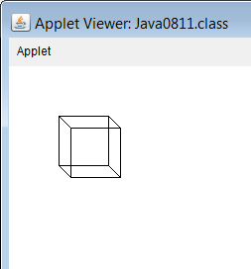

// Java0811.java Cube Casestudy #2
// Stage #2 presents adds a <draw> method to display one cube object.
public class Java0811 extends Applet
{
public void paint(Graphics g)
{
Cube cube = new Cube(g);
cube.draw(g);
}
}
class Cube
{
private int tlX; // topleft X coordinate of the Cube's position
private int tlY; // topleft y coordinate of the Cube's position
public Cube(Graphics g) { tlX = 50; tlY = 50; }
public void draw(Graphics g)
{
int tlX2 = tlX + 12;
int tlY2 = tlY + 12;
g.setColor(Color.black);
g.drawRect(tlX,tlY,50,50);
g.drawRect(tlX2,tlY2,50,50);
g.drawLine(tlX,tlY,tlX2,tlY2);
g.drawLine(tlX+50,tlY,tlX2+50,tlY2);
g.drawLine(tlX,tlY+50,tlX2,tlY2+50);
g.drawLine(tlX+50,tlY+50,tlX2+50,tlY2+50);
}
}
Notes:
Cube Case Study, Stage #2
The constructor initializes the starting coordinates of a cube objects at [50,50]. Is there any magic in those numbers? No, there is not, but some values need to be selected and [50,50] will do nicely. Program Java0811.java, in figure 8.11, alters the constructor and includes a call to the new draw method. Method draw draws a cube at the current value of tlX and tlY. The result is a single cube.

Slide 33
// Java0812.java Cube Casestudy #3 // Stage #3 adds a second, overloaded constructor. // It is now possible to specify the size and the location of the cube. // The <draw> method needs to be altered to handle different cube sizes.
import java.awt.*; import java.applet.*; public class Java0812 extends Applet { public void paint(Graphics g) { Cube cube1 = new Cube(g,50,50,50); cube1.draw(g); Cube cube2 = new Cube(g,400,50,100); cube2.draw(g); Cube cube3 = new Cube(g,50,300,150); cube3.draw(g); Cube cube4 = new Cube(g,400,300,200); cube4.draw(g); } } class Cube { private int tlX; private int tlY; private int size; | public Cube(Graphics g) { tlX = 50; tlY = 50; size = 50; } public Cube(Graphics g, int x, int y, int s) { tlX = x; tlY = y; size = s; } public void draw(Graphics g) { int tlX2 = tlX + size/3; int tlY2 = tlY + size/3; g.setColor(Color.black); g.drawRect(tlX,tlY,size,size); g.drawRect(tlX2,tlY2,size,size); g.drawLine(tlX,tlY,tlX2,tlY2); g.drawLine(tlX+size,tlY,tlX2+size,tlY2); g.drawLine(tlX,tlY+size,tlX2,tlY2+size); g.drawLine(tlX+size,tlY+size,tlX2+size,tlY2+size); } }
Notes:
Cube Case Study, Stage #3
Program Java0812.java, in figure 8.12, adds a second constructor, which can specify the initial coordinate values of the cube object as well as its size. This third stage is not only a matter of adding a second constructor. The draw method now has issues. It has many 50s throughout because every cube it draws is 50 pixels wide and 50 pixels tall. Now the method needs to be more general and handle cubes of any size. The consequence is a new improved draw method capable of drawing cubes not only at any location, but also any size.

Slide 34
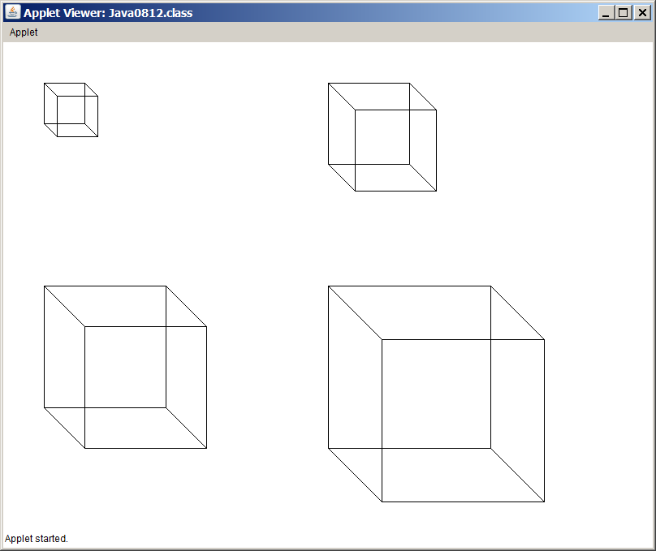

Slide 35
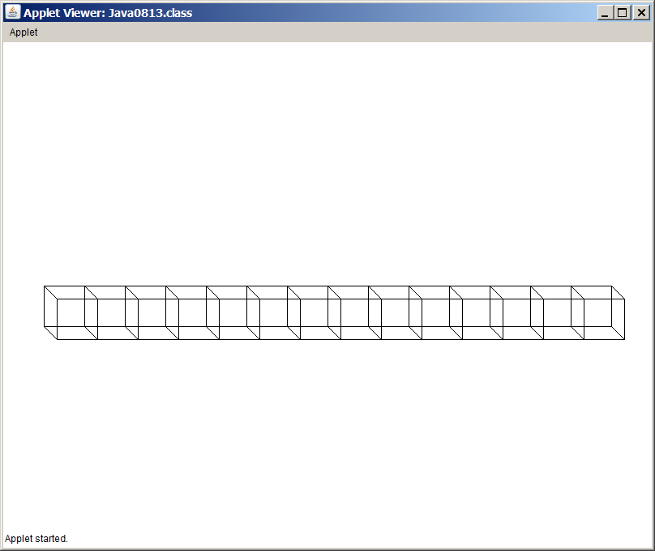

// Java0813.java Cube Casestudy #4
// Stage #4 adds a <move> method, which updates the cube's coordinates
// and draws a cube at the new location.
// Only new methods are shown.
public class Java0813 extends Applet
{
public void paint(Graphics g)
{
Cube cube = new Cube(g,50,50,50);
for (int x = 50; x < 750; x += 50)
cube.move(g,x,300);
}
}
class Cube
{
private int tlX; // topleft X coordinate of the Cube's position
private int tlY; // topleft y coordinate of the Cube's position
private int size; // the size of the cube along one edge
public void move(Graphics g, int x, int y)
{
tlX = x; tlY = y; draw(g);
}
}
Notes:
Program Java0813.java, in figure 8.13, adds the move method. It is now possible to relocate a cube to a new location after the initial construction of the cube object.

Slide 36
// Java0814.java Cube Casestudy #5 // Stage #5 adds an <erase> method, which erases the cube at the current [tlX,tlY] coordinates. // This program has a problem because the cube object is erased immediately after it is drawn.
import java.awt.*; import java.applet.*; public class Java0814 extends Applet { public void paint(Graphics g) { Cube cube = new Cube(g,50,50,50); for (int x = 50; x < 750; x += 50) { cube.move(g,x,300); cube.erase(g); } } } | class Cube { private int tlX; // topleft X coordinate of the Cube's position private int tlY; // topleft y coordinate of the Cube's position private int size; // the size of the cube along one edge public void erase(Graphics g) { int tlX2 = tlX + size/3; int tlY2 = tlY + size/3; g.setColor(Color.white); g.drawRect(tlX,tlY,size,size); g.drawRect(tlX2,tlY2,size,size); g.drawLine(tlX,tlY,tlX2,tlY2); g.drawLine(tlX+size,tlY,tlX2+size,tlY2); g.drawLine(tlX,tlY+size,tlX2,tlY2+size); g.drawLine(tlX+size,tlY+size,tlX2+size,tlY2+size); } }
Notes:
Let's see if we can have some fun. Everybody likes animation. Moving objects simply is far more exciting than static objects going no place. Program Java0814.java, in figure 8.14, shows a Cube class with an erase method. The aim is to move the cube to a new location and then erase the cube from the previous location. What you see if a simple introduction to animation. Actually, you see absolutely nothing because the move and erase occur so quickly that the last cube location is erased before you had a chance to see anything.

Slide 37
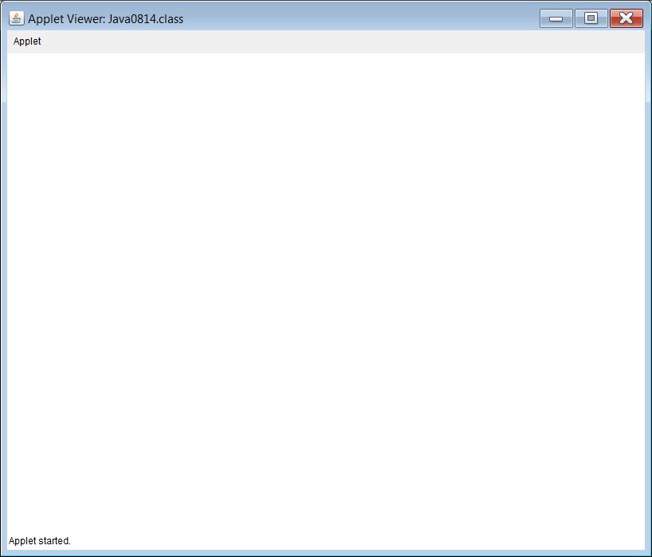
It seams like there is no output.
The problem is the output is
so fast you cannot see it.

Slide 38

// Java0815.java Cube Casestudy #6 // Stage #6 adds a <delay> method which stops program execution for a specified number of // milli seconds. This makes the cube visible and creates a simple type of animation.
import java.awt.*; import java.applet.*; public class Java0815 extends Applet { public void paint(Graphics g) { Cube cube = new Cube(g,50,50,50); for (int x = 50; x < 750; x += 50) { cube.move(g,x,300); cube.delay(100); cube.erase(g); } } } | class Cube { private int tlX; // topleft X coordinate of the Cube's position private int tlY; // topleft y coordinate of the Cube's position private int size; // the size of the cube along one edge public void delay(int n) { long startDelay = System.currentTimeMillis(); long endDelay = 0; while (endDelay - startDelay < n) endDelay = System.currentTimeMillis(); } }
Notes:
Our Cube class needs a small, clever method to help with this animation stuff. It is called method delay. Method delay stops program execution for a specified number of milliseconds. It is now possible to slow down the program execution sufficiently to observe some movement with Java0815.java, in figure 8.15.

Slide 39

Note: Output simulated
with PowerPoint
Try This:
For smoother output
change the delay to 10
and the x+=20 to x+=2.
Notes:
Make sure that you observe the program execution on a computer. If you look at the textbook page, you will see the cube in one location. The output display captured the cube on its path, but it does move.

Slide 40
// Java0816.java Cube Casestudy #7 // Stage #7 adds three methods that return the values of instance variables. // They are methods <getX>, <getY> and <getSize>.
import java.awt.*; import java.applet.*; public class Java0816 extends Applet { public void paint(Graphics g) { Cube cube = new Cube(g,50,50,50); Cube cube = new Cube(g,400,300,200); cube.draw(g); System.out.println("Top Left X: " + cube.getX()); System.out.println("Top Left Y: " + cube.getY()); System.out.println("Cube Size: " + cube.getSize()); } | class Cube { private int tlX; // topleft X coordinate of the Cube's position private int tlY; // topleft y coordinate of the Cube's position private int size; // the size of the cube along one edge public int getX() { return tlX; } public int getY() { return tlY; } public int getSize() { return size; } }
Outputs shown on the next 3 slides.
Notes:
Cube Case Study, Stage #7
Animation is fun, but we need to return to reality. The last stage in this case study is Java0816.java, in figure 8.16. The Cube class adds three important get methods that return the data of the Cube object. In a graphics program this type of information is especially important for debugging purposes when data values need to checked. The program below is not complete.

Slide 41
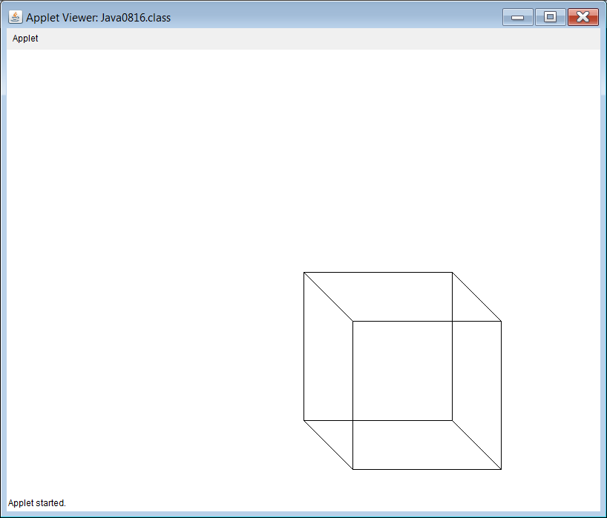
GUI Output of
Program Java0816.java
Notes:
This program displays a single large cube, but behind the graphics window you will see a text window that displays the data attribute values.

Slide 42
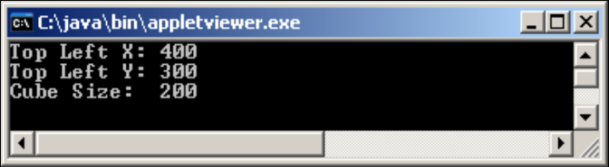
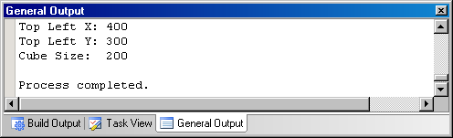
Located behind the GUI window
Possible Text Outputs of
Program Java0816.java
Located at the bottom of JCreator

Slide 43
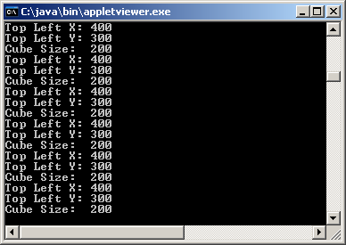
Weird Output!
You might get this output when switching between the GUI and Text windows.
This happens if you drag something in front of the GUI window or resize it.
The GUI window will need to be refreshed which will cause the paint method to be called repeatedly.

Slide 44
Section 8.7
The Consequences
of Scope
Notes:
The next topic in this chapter may seem to be outside the encapsulation business. Read carefully and play with the program examples. This is not a "pure" OOP topic, but it is important and scope must be understood properly to create correct classes and methods.

Slide 45
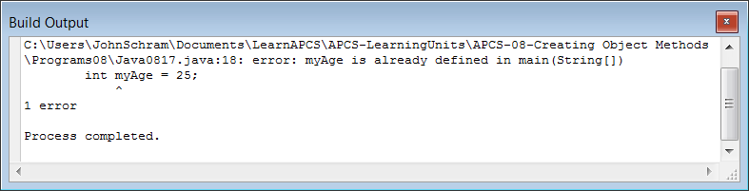
// Java0817.java
// This program demonstrates how one variable name <counter>
// can be declared twice correctly.
// It also shows <myAge> declared twice incorrectly.
public class Java0817
{
public static void main(String args[])
{
for (int counter = 1; counter <= 5; counter++)
System.out.print(counter + " ");
for (int counter = 10; counter <= 15; counter++)
System.out.print(counter + " ");
int myAge = 16;
int myAge = 25;
}
}
Notes:
Consider program Java0817.java, in figure 8.17. This program defines variable counter twice, followed by a double definition of myAge. The program does not compile. Perhaps you are not surprised, because duplicate definitions are not allowed and yet the error message is only concerned about the duplicate definition of myAge. Apparently Java does not get excited about a double counter. The issue is a matter of understanding scope.

Slide 46
// Java0818.java
// This program demonstrates the scope of a variable.
public class Java0818
{
public static void main(String args[])
{
int var1 = 10;
System.out.println("var1 in main is " + var1);
System.out.print("var2 inside the main method for loop is ");
for (int var2 = 1; var2 < 10; var2++)
{
System.out.print(var2 + " ");
}
System.out.println();
Boo boo = new Boo(var1);
System.out.println("var4 in Boo is " + boo.getData());
System.out.println();
}
}
Notes:
Program Java0818.java, in figure 8.18, is a little strange looking. There are four variables defined in various locations of the file. This program is odd in the practical sense, but created to demonstrate the scope of four different variables.

Slide 47
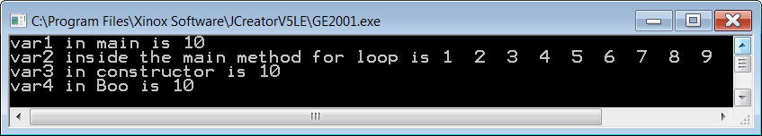
class Boo
{
private int var4;
public Boo(int var3)
{
var4 = var3;
System.out.println("var3 in constructor is " + var3);
}
public int getData()
{
return var4;
}
}

Slide 48
// Java0818.java
// This program demonstrates the scope of a variable.
public class Java0818
{
public static void main(String args[])
{
int var1 = 10;
System.out.println("var1 in main is " + var1);
System.out.print("var2 inside the main method for loop is ");
for (int var2 = 1; var2 < 10; var2++)
{
System.out.print(var2 + " ");
}
System.out.println();
Boo boo = new Boo(var1);
System.out.println("var4 in Boo is " + boo.getData());
System.out.println();
}
}
Scope of var1
Notes:
Identifier var1, in figure 8.19, is declared in main and has access for the entire main method.

Slide 49
// Java0818.java
// This program demonstrates the scope of a variable.
public class Java0818
{
public static void main(String args[])
{
int var1 = 10;
System.out.println("var1 in main is " + var1);
System.out.print("var2 inside the main method for loop is ");
for (int var2 = 1; var2 < 10; var2++)
{
System.out.print(var2 + " ");
}
System.out.println();
Boo boo = new Boo(var1);
System.out.println("var4 in Boo is " + boo.getData());
System.out.println();
}
}
Scope of var2
Notes:
Identifier var2, in figure v8.20, is also defined in main, but the scope is limited to the for loop heading and body.

Slide 50
class Boo
{
private int var4;
public Boo(int var3)
{
var4 = var3;
System.out.println("var3 in constructor is " + var3);
}
public int getData()
{
return var4;
}
}
Scope of var3
Notes:
Identifier var3, in figure 8.21, has a scope limited to the constructor of Boo

Slide 51
class Boo
{
private int var4;
public Boo(int var3)
{
var4 = var3;
System.out.println("var3 in constructor is " + var3);
}
public int getData()
{
return var4;
}
}
Scope of var4
Notes:
and finally, identifier var4, in figure8.22, has scope of the entire Boo class.

Slide 52
Scope Definition
What is scope? The scope of a variable - simple, primitive data type or complex object - is the segment of a program during which a variable is defined, has allocated memory to store values and can be accessed.
If two variables have the same identifier and also the same scope, Java will object with a duplicate definition compile error.
Notes:
What is scope? The scope of a variable - simple, primitive data type or complex object - is the segment of a program during which a variable is defined, has allocated memory to store values and can be accessed.
You can think of scope somewhat like jurisdiction of a police department. Dallas police officers have jurisdiction in the city of Dallas only. The Dallas county sheriff's department has jurisdiction over the entire county of Dallas, which includes the city of Dallas. The Texas state troopers have jurisdiction over the entire state of Texas, which includes Dallas county and the city of Dallas.

Slide 53
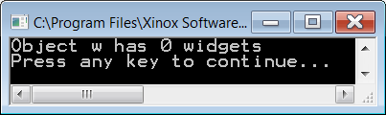
// Java0819.java
// This program shows the logic problem that results from using two variables
// with the same name identifier, but two different scopes.
public class Java0819
{
public static void main(String args[])
{
Widget w = new Widget(100);
System.out.println("Object w has " + w.getWidgets() + " widgets");
}
}
class Widget
{
private int numWidgets;
public Widget(int numWidgets)
{
numWidgets = numWidgets;
}
public int getWidgets()
{
return numWidgets;
}
}
Notes:
This approach can cause a logic error that is shown by Java0819.java, in this example. When the Widget object w is constructed, value 100 is passed to the constructor. The intent is that the new object will store 100 widgets. The reality is that not a single widget is stored and numWidgets returns an initial default value of 0.
The problem is the highlighted numWidgets = numWidgets statement. This identifier is identical to the Widget private attribute numWidget. There is no compile issue with this approach, because numWidget in the constructor and numWidget as the class attribute have different scope. Java is fine. It is great that everybody is fine, but it also means that value 100 does not go anywhere beyond the constructor.

Slide 54
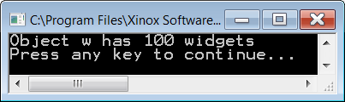
// Java0820.java
// Using different variable names is one solution to the
// problem caused by program Java0819.java.
public class Java0820
{
public static void main(String args[])
{
Widget w = new Widget(100);
System.out.println("Object w has " + w.getWidgets() + " widgets");
}
}
class Widget
{
private int numWidgets;
public Widget(int nW)
{
numWidgets = nW;
}
public int getWidgets()
{
return numWidgets;
}
}
Notes:
There are two solutions to solve this logic error and do remember that logic errors will never create any type of compile error message or runtime exception indication.
Java lets the programmer deal with logic errors.
The first solution is shown by Java0820.java, in this example. Use a different identifier for the formal parameter in the method heading than the attribute identifier. The program output now displays the correct output. The logic error is removed. This solves the problem nicely for most people. Many programmers prefer this style of programming, but the same identifier group is not happy.

Slide 55
// Java0821.java
// Using the <this> reference is a second solution to the
// problem in program Java0819.java.
public class Java0821
{
public static void main(String args[])
{
Widget w = new Widget(100);
System.out.println("Object w has " + w.getWidgets() + " widgets");
}
}
class Widget
{
private int numWidgets;
public Widget(int numWidgets)
{
this.numWidgets = numWidgets; // required use of this
}
public int getWidgets()
{
return this.numWidgets; // optional use of this
}
}
Notes:
There is a way to make our same identifier people happy. Java has a special keyword called this. this is a reference and stores a memory value. Specifically, this stores the reference value of the current object in use. Java0821.java, in figure 8.25, has a second solution to the logic error of program Java0819.java.
The statement this.numWidgets = numWidgets now makes perfect sense to Java. The first numWidgets is the attribute of the object being called, which in this case is being constructed. Java knows this (normal English this) because this has the same reference as object w.
In method getWidgets the this reference is also used, but in that case it is optional. There is no possible confusion for Java. Inside method getWidgets is no definition of numWidgets. To Java this means that the attribute numWidgets, which has scope in the entire class is the intended variable. Technically, numWidgets has scope everywhere in class Widget, but the local declaration of numWidgets in the constructor has priority over the global class definition.

Slide 56
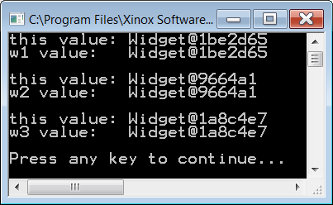
// Java0822.java
// Comparing the value of the three <Widget> objects demonstrates
// that the <this> reference value is equal to the current object used.
public class Java0822
{
public static void main(String args[])
{
Widget w1 = new Widget(100);
System.out.println("w1 value: " + w1);
System.out.println();
Widget w2 = new Widget(100);
System.out.println("w2 value: " + w2);
System.out.println();
Widget w3 = new Widget(100);
System.out.println("w3 value: " + w3);
System.out.println();
}
}
class Widget
{
private int numWidgets;
public Widget(int numWidgets)
{
this.numWidgets = numWidgets;
System.out.println("this value: " + this);
}
}
Notes:
The proper use of this is very important in encapsulation. If it is not quite clear yet what exactly this references, look at program Java0822.java, in figure 8.26. In this program you will three objects of the Widget class instantiated. In each case the value of the object is displayed. Since objects store a memory reference to the location where the data is stored, the output becomes a memory location. Java usually starts with the name of the class followed by the memory address.
There is also a println statement inside the constructor of the Widget class and the value printed is this. Look closely at the output. You will first see the value of this, followed by the value of w1, then w2 and finally w3. Three different memory locations will be shown for each one of the Widget objects. In each case the memory location is the same as the current object in context. In other words when I am working with w1 then this has the same value as w1. Likewise when new memory is located for w2 you will see that this also gets this new address.

Slide 57
this & void
this references the object in context. This means that in a statement, such as tom.makeDeposit(1000), the reference address stored by tom will be identical to this when used inside the makeDeposit method.
A void method can have a return statement as long as it does not return anything.
This return simply exits the method.

Slide 58
Section 8.8
Method
Summary
Notes:
The primary focus of this chapter was on creating object methods as opposed to creating class methods introduced in the last chapter. By now you have already seen an amazing number of different methods.
In an effort to clarify all these methods, this chapter will conclude with a review of each type of method.
Each method will be briefly explained and then an example of such a method is shown to review the precise Java syntax that is required.

Slide 59
Class or Static Methods
Class methods are sometimes called static methods because they have the keyword static in their heading.
A class method is called with the class identifier, not with an object of the class.
This is practical when there is no need to make multiple objects of a class.
A good example is Java’s Math class.
Notes:
A class method calls the class directly, not an object of the class. This is practical when there is no need to make multiple copies of a class. A good example is Java’s Math class.
Everybody can use the methods of the Math class and there is no need to make multiple objects. The value of PI will be same with everybody using this class. Use the reserved word static at the start of a method heading to indicate that the method is a class method.

Slide 60
Class or Static Methods
public class Demo
{
public static void main(String args[])
{
Piggy.initData();
Piggy.showData();
Piggy.addData(1200);
Piggy.showData();
}
}
class Piggy
{
public static double savings;
public static void initData() { savings = 0; }
public static void addData(double s) { savings += s; }
public static void showData() { System.out.println("Savings: " + savings); }
}
Notes:
In this example, notice how each method in the Piggy class is called by using the class identifier Piggy.

Slide 61
Object or Non-Static Methods
Object methods are sometimes called non-static methods because they do NOT have the keyword static in their heading.
Object methods are meant for those situations where multiple objects of a class must be constructed.
An object must be constructed first with the new operator, and then object methods are called by using the object identifier.
Notes:
Object methods are meant for those situations where multiple copies of a class must be constructed. The essence of the method does not change.
What really changes is the fact that now an object must be constructed first with the new operator, and then the method can be called.
In contrast to the class methods, object methods are called by using the object identifier.

Slide 62

Object or Non-Static Methods
public class Demo
{
public static void main(String args[])
{
Piggy tom = new Piggy();
tom.initData();
tom.showData();
tom.addData(1200);
tom.showData();
}
}
class Piggy
{
private double savings;
public void initData() { savings = 0; }
public void addData(double s) { savings += s; }
public void showData() { System.out.println("Savings: " + savings); }
}
Notes:
In the example shown, the same Piggy class is used, with the same methods.
Now the methods do not use the static keyword and this example shows that any object must be called with an object identifier, like tom.
Java is a free-form language and programming style is a matter of convention and taste. Frequently, small methods are written on a single line.

Slide 63

Private or Helper Methods
Occasionally, a method is created in a class that is never called outside of the class.
In such a case, the method
should be declared private.
These private methods are sometimes called helper methods because they help and support the other methods of the class.
Notes:
Private methods can only be accessed by methods of the same class.
Normally, such methods are called helper methods and they assist other methods that will be used by some client program of the class.
private void shuffleCards()
{
System.out.println("Shuffle Cards");
}

Slide 64

Public Methods
Essentially, public methods
can be accessed anywhere.
The majority of methods are public.
public int getCards()
{
return cardsLeft;
}
Notes:
A public method can be accessed by members of the same class, and more importantly public methods can be accessed by any client of the class. The majority of methods are public

Slide 65
Void Methods
Void methods do NOT return a value and use the reserved word void to indicate that no value will be returned.
public void showData()
{
System.out.println("Name: " + name);
System.out.println("Savings: " + savings);
}
Notes:
There are many ways to classify methods. Methods are not just public only, or private only, or static only, or anything else only. You, personally, have many classifications at the same time. You can be a Sophomore, Junior or Senior. At the same time you can be Male or Female. You can also belong to a religious group and you can be Catholic, Muslim, Jewish, Protestant or non-denominational or no religion at all.
Classification also can be based on school organizations. You can be a band member, cheerleader, football player, gymnast, soccer player, academic decathlon member, etc.
The point is do not be surprised if you see that a method shows up in many different classifications. The method shown here is a public method, but for the purpose of this classification we are interested in the fact that it is a void method.
Void methods do not return a value and use the reserved word void to indicate that no value will be returned.

Slide 66
Return Methods
Return methods are methods that return a value.
Two features are necessary for a return method:
First, you will see that the method heading indicates a data type, which is the type that the method returns.
Second, you see a return statement at the end of the method body.
public double getSavings()
{
return savings;
}
Notes:
Return methods are methods that return a value.
Two features are necessary for a return method, and look for them in this example.
First, you will see that the method heading indicates a data type, which is the type that the method returns.
Second, you see a return statement in the method body.

Slide 67

Default Constructor Methods
A constructor is a special method that is automatically called during the instantiation
of a new object.
If no visible constructor is provided, Java will provide its own constructor, called a
default constructor.
Additionally, we also call a
no-parameter constructor
a default constructor.
public CardDeck()
{
numDecks = 1;
numPlayers = 1;
cardsLeft = 52;
shuffleCards();
}
Notes:
A constructor is a special method that is automatically called during the instantiation of a new object.
If no visible constructor is provided Java will provide its own constructor, called a default constructor. I also call a no-parameter constructor a default constructor, like the example shown in this example.
Constructors are always public and they are special methods that are neither void nor return methods.

Slide 68




Overloaded Constructor Methods
An overloaded constructor is a second, third or more, constructor that allows a new object to be instantiated according to some specifications that are passed by parameters.
public CardDeck(int d, int p)
{
numDecks = d;
numPlayers = p;
cardsLeft = d * 52;
shuffleCards();
}
Notes:
An overloaded constructor is a second, third or more constructor that allows a new object to be instantiated according to some specifications that are passed by parameters.
This example shows an overloaded CardDeck constructor, which enters numDecks and numPlayers information.

Slide 69
Accessing or Get Methods
Methods that only access object data without altering the data are called accessing or get methods.
Most accessing methods are return methods, which return object private data information.
public int getDecks()
{
return numDecks;
}
Notes:
Methods that only access object data without altering the data are access methods or frequently called get methods. Frequently access methods are return methods, which return object private data information.
The example here returns the value of numDecks.

Slide 70

Altering or Modifier or Mutator or Set Methods
These are methods that not only access the private data of an object; they also alter the value of the data.
public void savingsDeposit(double s)
{
savings += s;
}
Notes:
Altering methods are sometimes also called modifier methods or mutator methods or set methods.
These are methods that not only access the private data of an object; they also alter the value of the data.
The example in here accesses the savings attribute and adds the value of s to it.

