Slide 1
Exposure Java 2013
APCS Edition
Chapter 9 Slides
Focus on OOP:
Class Interaction with Inheritance
PowerPoint Presentation
created by:
Mr. John L. M. Schram
and Mr. Leon Schram
Authors of Exposure Java
Notes:
Chapter IV introduced Object Oriented Programming. We took small steps and started by explaining how to use class methods and object methods. In some later chapters you learned how to declare your own classes and how to create your own class methods and object methods. These early chapters set the stage so that you would be ready to understand Object Oriented Programming more formally. Encapsulation was explained in the last chapter and started the first OOP focus. Encapsulation is the OOP feature whereby the data of an object and all the methods, which access the data, are placed in the same container. Understanding encapsulation is very important in learning OOP, but it is only the first step.
The previous chapter taught you how to create a class and how to create the attributes and methods that are members of the class. You also observed that a second testing class was used to see if your new class works properly. Besides learning how to test a class, nothing was shown about how multiple classes are used together. How do they connect? How do they interact? This is the second OOP focus that will be discussed in this chapter. Class interaction is further divided into inheritance and composition. We will investigate inheritance first.
You have already seen and used inheritance in many previous program examples. In chapter IV you were introduced to using graphics in Java and creating applets for web pages. In each one of your applet programs the class heading was followed with the words extends Applet. Little was mentioned about those words, but those two little words indicate that the current class will be using features that have already been declared in the Applet class.

Slide 2
Section 9.2
“Is-A” & “Has-A”
Relationships
Notes:
A programming language is initially so complex that it is necessary to use various language features that are not immediately explained. Explaining everything may be very thorough, but such an approach will be very intimidating and certainly overwhelming. Now you are ready to explore inheritance.
Students frequently make a common mistake with inheritance. They confuse the "is-a" relationship with the "has-a" relationship. Both relationships involve class interaction and both are very useful in computer science, but they are very different. Go back to the van example. Our van custom converter started with a fully functional van and customized it. The finished product “is-a” van.

Slide 3
Inheritance
Inheritance is the process of using features (both attributes and methods) from an existing class.
The existing class is called the superclass and the new class, which inherits the superclass features, is called the subclass.
superclass: Car
subclasses:
Truck, Limo & Racecar
Notes:
Now when the van was first assembled it was a different story. Many different assembly lines converged to create the van. The van “has-an” engine, and it “has-a” transmission, and it “has” doors. The van is composed of many parts, but it is incorrect to state a van “is-a” door.
The confusion starts because in both cases something new is created with existing components. However there is a big difference between the two creations. With composition a new item is created that is composed of many existing parts. This is the case of assembling a van with a frame, wheels, doors, seats, engine, and all the other van parts.
Now inheritance also uses something that already exists, but the whole item is used and then enhanced. A square is a special type of rectangle. A tiger is one particular type of cat. An off-road truck is first a truck. Take the example of the off-road truck. You can buy a regular truck. Now you put in special shocks that provide greater clearance. You also add four-wheel drive and a locking differential feature. You add special tires that will do well in mud and snow and your original truck is now an off-road truck. However, it is still a truck.

Slide 4
“Is-A” and “Has-A”
The creation of new classes with the help of existing classes makes an important distinction between two approaches.
An "is-a" relationship declares a new class as a special “new-and-improved” case of an existing class. In Geometry, a parallelogram "is-a" quadrilateral with special properties.
A “has-a” relationship declares a new class composed of an existing class or classes. A line "has" points, a square "has" lines, and a cube "has" squares.
A truck "is-a" car, but it "has-an" engine.
In computer science an "is-a" relationship involves class interaction that is called inheritance and a "has-a" relationship involves class interaction that is called composition.
Notes:
Geometry
computer science and see how this inheritance business might apply. You are a number-one-awesome programmer and you have just finished creating a Window class. Now this Window class is a beauty, because you can now display a window anywhere on the monitor. The window can minimize, maximize and you can drag the window to any location. You are rightfully very proud of your new Window class.
Now you want to expand the capability of your Window class and use it to enter text. This adds a whole new dimension of capabilities to your humble Window class. Now, your new class - let us call it TextWindow - needs to still do everything that the plain old vanilla Window class did and more. It is possible to start from scratch, but that would be as efficient as our van converter person who first builds his own vans from scratch before customizing them for special needs. The secret is to start with the Window class and use all its capabilities for a new class called TextWindow. In computer science we say that TextWindow inherits from Window. Such an approach saves time and it adds tons of reliability. Just imagine that you are using an existing class that withstood the test of time. The class has been used over and over again, and all the bugs are corrected. Everybody is happy with your nifty Window class. Now do not touch or alter Window. Start a new class, but do it in such a way that it is capable of using all the nicely tested features that are available with the existing Window class. In a nutshell that is inheritance.

Slide 5
Subclass Methods
Never alter a well-designed, and tested, existing class.
Write a new subclass class to use the methods of the existing class and create new methods in your new class.
Write methods in the subclass that are re-definitions
of the existing superclass methods or write totally new-definitions.

Slide 6
Section 9.4
Accessing
Class
Members

Slide 7
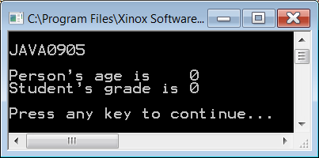
// Java0905.java
// This program demonstrates fundamental inheritance with <extends>.
// There are no constructors yet, which results in Java handling the
// construction and assigning default values to the attributes.
public class Java0905
{
public static void main(String args[])
{
System.out.println("\nJAVA0905\n");
Student tom = new Student();
System.out.println("Person's age is " + tom.getAge());
System.out.println("Student's grade is " + tom.getGrade());
System.out.println();
}
}
class Person
{
private int age;
public int getAge() { return age; }
}
class Student extends Person
{
private int grade;
public int getGrade() { return grade; }
}
Notes:
We continue now with a series of simple programs to clarify the syntax of inheritance and also to demonstrate how a subclass has access to members of a superclass. Program Java0905.java, in figure 9.13 shows a program that starts with a Person class. The Person class is not very impressive since it has only one attribute, age, and only one method, getAge. A second class, Student, inherits the Person capabilities. This means that Student is-a Person. The Student class is equally skimpy and has one attribute, grade, and one method, getGrade.
Program Java0905.java shows the required syntax to implement inheritance. Person is the superclass, and Student is the subclass, which inherits from Person. The declaration of the Student class starts with the customary statement class Student, and then it is followed with extends Person. The keyword extends is the secret of inheritance in Java syntax. With extends the Java compiler is told that the new subclass has access to the features of the superclass, which is mentioned after the extends statement.
Do you see proof of inheritance? Take a look at the main method. Only one object is constructed. It is tom, which is a Student object. Now observe that the tom object calls both the getAge and getGrade methods. This is great but getAge is not a Student method. It is possible to access this method precisely because Student is a subclass of superclass Person.

Slide 8
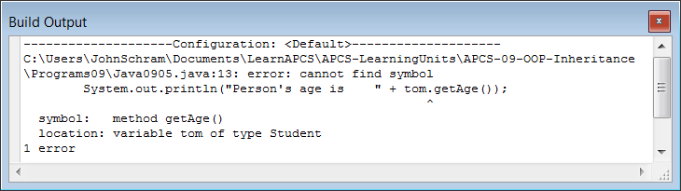
// Java0905.java
// This program demonstrates fundamental inheritance with <extends>.
// There are no constructors yet, which results in Java handling the
// construction and assigning default values to the attributes.
public class Java0905
{
public static void main(String args[])
{
System.out.println("\nJAVA0905\n");
Student tom = new Student();
System.out.println("Person's age is " + tom.getAge());
System.out.println("Student's grade is " + tom.getGrade());
System.out.println();
}
}
class Person
{
private int age;
public int getAge() { return age; }
}
class Student // extends Person
{
private int grade;
public int getGrade() { return grade; }
}
Output with extends Person removed.
Notes:
Try a quick experiment. Delete the two words extends Person and recompile the program. Figure 9.14 shows Java's response. The Person class and the Student class no longer have any class interaction. It is now impossible to call a Person method by using the Student object tom.
We have seen proof that extends Person gives access to a method in the Person with a Student object. Does this work in both directions? Can a superclass object access a method in a subclass? Program Java0906.java, in figure 9.15 checks that possibility.

Slide 9

// Java0906.java
// This program reverses the access between the classes.
// A person object now tries to access a subclass method.
public class Java0906
{
public static void main(String args[])
{
System.out.println("\nJAVA0906\n");
Person tom = new Person();
System.out.println("Person's age is " + tom.getAge());
System.out.println("Student's grade is " + tom.getGrade());
System.out.println();
}
}
class Person
{
private int age;
public int getAge() { return age; }
}
class Student extends Person
{
private int grade;
public int getGrade() { return grade; }
}
Notes:
This experiment falls into the category of nice try. Figure 9.16 shows that Java cannot digest this type of interaction. Now think about this. Class interaction is meant to take advantage of using established classes. We say class interaction, but this is not meant to be in both directions. One class already exists and supposedly is well written and thoroughly tested. This existing class now becomes the superclass for a new class that takes advantage of the available members of the superclass and defines some of its own methods.

Slide 10
Access with Inheritance
When two classes have an inheritance interaction then access is only possible from the subclass to the superclass members.
It is not possible to access subclass members from the superclass.
Notes:
Class access has been limited to methods so far. What happens when a subclass tries to access the data attributes of a super class?

Slide 11
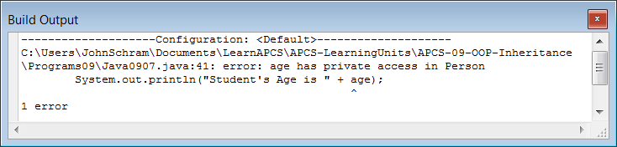
// Java0907.java
// This program shows that the subclass does not have access to the private data of the superclass.
// This program will not compile.
public class Java0907
{
public static void main(String args[])
{
System.out.println("\nJAVA0907\n");
Student tom = new Student();
tom.showData();
System.out.println();
}
}
class Person
{
private int age;
public Person() { age = 17; }
}
class Student extends Person
{
private int grade;
public Student() { grade = 12; }
public void showData()
{
System.out.println("Student's Grade is " + grade);
System.out.println("Student's Age is " + age);
}
}
Notes:
Program Java0907.java, in figure 9.17, answers that question. In this program is a Student method, called showData. It is written to display the data attribute values of the Person superclass, as well as the Student subclass.
You have seen how get methods are designed to return the values of data attributes. This is not the intention here. The showData method goes straight to the data fields and intents to display them.
The experiment is quickly stopped. Java makes it quite clear that access to private data is not allowed, even from a proper subclass. Private means private and only local members have direct access. Figure 9.18 displays the stern warning by Java that you are very confused. Notice that the error applies to age only. Access to the grade data field is permitted. grade is a local attribute of the Student class.

Slide 12
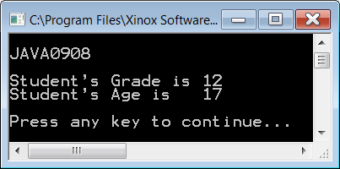
// Java0908.java
// This program changes private member data to "protected" data.
// The <Student> class can now access data from the <Person> class.
public class Java0908
{
public static void main(String args[])
{
System.out.println("\nJAVA0908\n");
Student tom = new Student();
tom.showData();
System.out.println();
}
}
class Person
{
protected int age;
public Person() { age = 17; }
}
class Student extends Person
{
protected int grade;
public Student() { grade = 12; }
public void showData()
{
System.out.println("Student's Grade is " + grade);
System.out.println("Student's Age is " + age);
}
}
Notes:
Now we have made a big deal in past chapters that data should only be accessed by special methods that access the data correctly. Basically, this may mean that you are not very disturbed about an inability to access data by a subclass. On the other hand, you could argue that a subclass is supposed to inherit all the features of the superclass, and does that not include the data of the superclass? This is a good point and Java's inheritance allows you to have your cake and eat it too.
It is possible to access data of the superclass, but that is not possible if the superclass data is declared private. The declaration needs to change to protected. Program Java0908.java, in figure 9.19, is almost identical to the previous program. The only change is that the data is now declared protected, not private. This time the program compiles just fine, and the subclass shows access to the data of the superclass.

Slide 13
public, private & protected
Attributes & methods declared public can be accessed by methods declared both outside and inside the class.
Attributes & methods declared private can only be accessed by methods declared inside the class.
Attributes & methods declared protected can be accessed by methods declared inside the class or subclass.
Notes:
Life used to be simple. Public items in a class can be accessed outside the class and private items can only be accessed inside the class. Now protected adds confusion to the simple rules. What does protected mean? Protected is an interesting hybrid. With protected you can access from outside the class, but only if you are a subclass. Any other class has no access. This means that protected, to a subclass behaves like public, but to other classes it behaves like private.

Slide 14
Section 9.5
Inheritance
Constructor
Issues
Notes:
Constructors play an important role in any class and you have learned that it is common that a class has multiple constructors. When classes interact you will find that the constructors also interact. Understanding the special requirements of constructors when inheritance is used insures that all classes operate as expected.

Slide 15
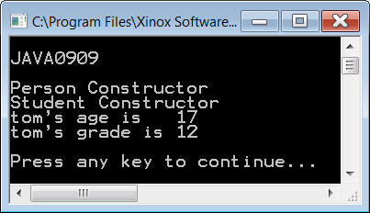
// Java0909.java
// This program adds output in the constructors to the <Person> and <Student> classes.
// Note how the <Person> constructor is called, even though there does
// not appear to be a <Person> object instantiated.
public class Java0909
{
public static void main(String args[])
{
System.out.println("\nJAVA0909\n");
Student tom = new Student();
System.out.println("tom's age is " + tom.getAge());
System.out.println("tom's grade is " + tom.getGrade());
System.out.println();
}
}
class Person
{
private int age;
public Person() { System.out.println("Person Constructor"); age = 17; }
public int getAge() { return age; }
}
class Student extends Person
{
private int grade;
public Student() { System.out.println("Student Constructor"); grade = 12; }
public int getGrade() { return grade; }
}
Notes:
Program Java0909.java, in figure 9.20, defines the Person and Student constructors with output statements.
There is a Student object, called tom, constructed. The single new operator calls the Student() constructor and it is reasonable in the output, that you see Student Constructor. What about the Person Constructor output?
There is not a new Person() statement in the program and yet the evidence displays that somehow the Person constructor is called.
Go back to the van analogy. If a custom van is-a van, does it not start with a plain-old-vanilla van first? In other words, is it not required first to construct a van before you can construct a custom van? This is precisely what happened in program Java0909.java. One object is instantiated, but the tom object starts its life by first becoming a Person and then becoming a Student.

Slide 16
// Java0910.java
// This program adds a call to <super> in the <Student> constructor.
// The program output is identical to the previous program.
// Java automatically makes the call to <super>.
class Student extends Person
{
private int grade;
public Student()
{
super();
System.out.println("Student Constructor");
grade = 12;
}
public int getGrade()
{
return grade;
}
}
// The other 2 classes and the output are identical
// to program Java0909 and are not shown here.
Notes:
Program Java0910.java helps to explain exactly how Java manages to handle this business of constructing a super class object first. The program is almost identical to the previous program and generates the exact same output. The only difference is shown in figure 9.21 where you can compare both of the two Student constructors. The second program uses a call to a super method, which calls the superclass constructor. A programmer can do this, as it was done in Java0910.java, but Java is happy to do this for you automatically. This is done, even if you do not provide the super statement in the subclass.

Slide 17
Inheritance and Constructor Calls
When an object of a subclass is instantiated, the constructor of the superclass is called first, followed by a call to the constructor of the subclass.
An invisible - to the programmer - call is made by Java to the super method, which generates a call to the superclass constructor. This statement can be written in the subclass constructor with the same results, but it is not required.
Notes:
You have seen various program examples involving both inheritance and constructors. In each case, evidence showed that the constructor of the superclass is executed first followed by executing the constructor of the subclass. In each example, the superclass constructor used was a no-parameter, default constructor. This begs the question what might happen if parameter constructors are used, and how is information passed in such a case on to the superclass?

Slide 18
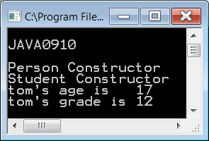
// Java0911.java
// This program demonstrates how a subclass
// constructor passes parameter information
// to a superclass constructor.
public class Java0911
{
public static void main(String args[])
{
System.out.println("\nJAVA0911\n");
Student tom = new Student(12,17);
tom.showData();
System.out.println();
}
}
class Person
{
protected int age;
public Person(int a)
{
System.out.println(
"Person Parameter Constructor");
age = a;
}
public int getAge() { return age; }
}
class Student extends Person
{
protected int grade;
public Student(int g, int a)
{
super(a); // this must be the first call
grade = g;
System.out.println(
"Student Parameter Constructor");
}
public int getGrade() { return grade; }
public void showData()
{
System.out.println("Student's Grade is "
+ getGrade());
System.out.println("Student's Age is "
+ getAge());
}
}
Notes:
Program Java0911.java, in figure 9.22, shows the data information path. The process starts by creating a new Student object tom. The Student constructor is called first with parameter information (12,17).
The 12 is meant to be the value for the grade data attribute of the Student class and the 17 is meant to be the value for the age data attribute of the Person class. The statement new Student(12,17) passes parameter values to the constructor method heading of Student. You have seen that a superclass object must be constructed first and that means that the 17 value needs to travel to the superclass constructor before anything can happen in the Student subclass constructor.
Note, that the very first statement in the subclass constructor is super(a). Variable a (for age) has received a copy of the actual parameter 17 and the superclass Person constructor is now called with the 17 value for age.
After the superclass is satisfied, the g parameter provides the 12 value to the grade attribute of the Student class. Java is happy and all the attributes have received the proper value in the proper sequence.

Slide 19
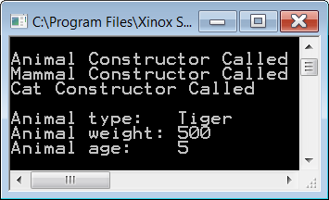
// Java0912.java
// This program demonstrates inheritance at three levels.
public class Java0912 { public static void main(String args[]) { System.out.println("\nJAVA0909\n"); Cat tiger = new Cat("Tiger",500,5); System.out.println(); System.out.println("Animal type: " + tiger.getType()); System.out.println("Animal weight: " + tiger.getWeight()); System.out.println("Animal age: " + tiger.getAge()); System.out.println(); } } class Animal { protected int age; public Animal(int a) { System.out.println("Animal Constructor Called"); age = a; } public int getAge() { return age; } } | class Mammal extends Animal { protected int weight; public Mammal(int w, int a) { super(a); weight = w; System.out.println( "Mammal Constructor Called"); } public int getWeight() { return weight; } } class Cat extends Mammal { protected String type; public Cat(String t, int w, int a) { super(w,a); type = t; System.out.println( "Cat Constructor Called"); } public String getType() { return type; } }
Notes:
This parameter passing business to superclass constructors can happen at multiple levels. Program Java0912.java, in figure 9.23, has three classes and information needs to be provided for attributes at three different levels.
The highest superclass is Animal. This is followed by Mammal, which extends Animal. In this situation Mammal is the subclass of Animal and simultaneously takes on the role of being the superclass of the Cat class. This type of interaction is actually quite natural when you view your own world. Every person is a child and then many children become parents. For many years a person will be both a child and a parent.
Parameter passing in this three-level inheritance example starts at the bottom. The testing class creates a Cat object tiger and calls the Cat constructor with three data values.
The Cat constructor receives the three data values and first passes two values to the superclass Mammal with the statement super(w,a). At the second level another super(a) statement is used to pass age to the highest super class. This process can be used a large number of inheritance levels.

Slide 20
Multi-Level Inheritance
& Multiple Inheritance
The previous program showed an example of Multi-Level Inheritance.
Multiple Inheritance is something different. It occurs when one subclass inherits from two or more superclasses.
This feature is available in C++.
It is NOT available in Java.
Notes:
When you talk about Multi-Level Inheritance, be careful that you say it properly. There is something else called Multiple Inheritance which sounds similar, but is completely different. In Multiple Inheritance, one subclass can have multiple super classes. The best way to explain the difference is to look at figure 9.24, below. A dinosaur is-a reptile, and a dinosaur is also extinct. Something else to keep in mind, Java allows Multi-Level Inheritance, but it does NOT allow Multiple Inheritance. Some languages, like C++, allow multiple inheritance.

Slide 21
Multi-Level Inheritance | Multiple Inheritance
Animal
Reptile
Extinct
Mammal
Dinosaur
Dog
Terrier

Slide 22
Section 9.6
super Calling a
SuperClass Method
Notes:
All the program examples have conveniently used method identifiers in the Person and Student class that are not identical. Considering the fact that a major reason for using inheritance is the re-definition of existing method, it should be quite common to use identical identifiers in multiple classes. How does Java handle this confusion?

Slide 23
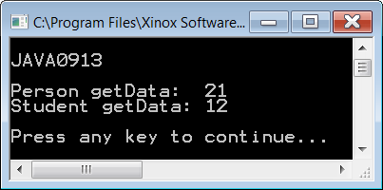
// Java0913.java
// In this program both the <Person> class and the <Student> class each have a <getData> method.
public class Java0913
{
public static void main(String args[])
{
System.out.println("\nJAVA0913\n");
Person ann = new Person();
Student tom = new Student();
System.out.println("Person getData: " + ann.getData());
System.out.println("Student getData: " + tom.getData());
System.out.println();
}
}
class Person
{
protected int age;
public Person() { age = 21; }
public int getData() { return age; }
}
class Student extends Person
{
protected int grade;
public Student() { grade = 12; }
public int getData() { return grade; }
}
Notes:
These questions are answered by this section starting with program Java0913.java, shown in figure 9.25. In that program example both the Person class and the Student class use method getData to return the data information of the class.
I am sure that you are not surprised by the program output in figure 9.25. There are two different methods with the same name, but the values returned are the values we want. This is not too tricky for Java. You call an ann Person object and you get ann's getData method. Then you continue and call a tom getData object and you get tom's getData method.
There was no confusion in Java0913.java. Java executes the method that is defined by the object that you are using. Fair enough. Now what happens if you have a Student object and you do not want to call the Student getData, you want the Person getData method.

Slide 24
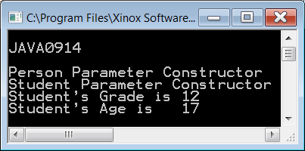
// Java0914.java
// This program demonstrates that it is possible
// to distinguish between two methods with the
// same identifier using <super>.
public class Java0914
{
public static void main(String args[])
{
System.out.println("\nJAVA0914\n");
Student tom = new Student(12,17);
tom.showData();
System.out.println();
}
}
class Person
{
protected int age;
public Person(int a)
{
System.out.println(
"Person Parameter Constructor");
age = a;
}
public int getData() { return age; }
}
class Student extends Person
{
protected int grade;
public Student(int g, int a)
{
super(a);
grade = g;
System.out.println(
"Student Parameter Constructor");
}
public int getData() { return grade; }
public void showData()
{
System.out.println("Student's Grade is "
+ getData());
System.out.println("Student's Age is "
+ super.getData());
}
}
Notes:
Program Java0914.java, in figure 9.26 actually calls getData twice with the intention to get two different values. This requirement is handled by using super in front of getData to indicate the superclass method.

Slide 25
Using super
The keyword super used as the first statement in a constructor passes information to the super class constructor, like super(a);
The same keyword super used in front of a method indicates that a method of the superclass needs to be called, like super.getData();
Information can be passed up to multiple inheritance levels, but it can only be passed one level at one time.

Slide 26

Section 9.7
Umbrella
Classes

Slide 27
SuperClass Declarations
You are used to seeing the same identifier at the start and end of an object definition, like
Student barry = new Student();
It is possible to declare an object with a superclass identifier and construct it with
a subclass identifier.
Person barry = new Student;

Slide 28
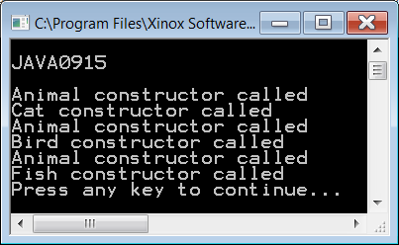



// Java0915.java // This program demonstrates that it is // possible to use the super class identifier // <Animal> to declare each subclass object. public class Java0915 { public static void main(String args[]) { Animal tiger = new Cat("Tiger"); Animal eagle = new Bird("Eagle"); Animal shark = new Fish("Shark"); } } class Animal { public Animal() { System.out.println( "Animal constructor called"); } } | class Cat extends Animal { protected String catType; public Cat(String ct) { System.out.println("Cat constructor called"); catType = ct; } } class Bird extends Animal { protected String birdType; public Bird(String bt) { System.out.println("Bird constructor called"); birdType = bt; } } class Fish extends Animal { protected String fishType; public Fish(String ft) { System.out.println("Fish constructor called"); fishType = ft; } }
Notes:
Start by looking at program Java0915.java, in figure 9.28. Specifically, look at the main method and observe how the objects are constructed. You are used to seeing the same identifier at the start and end of an object definition, like
Cat barry = new Cat();
What you see in this program example is quite different. There are three definitions and all three use the same class identifier, Animal, but then each object uses a different constructor, Cat, Bird and Fish. This type of Java code is quite common. Right now in this program there is little benefit. The program executes in the exact same manner if the declarations in figure 9.27 were used.

Slide 29
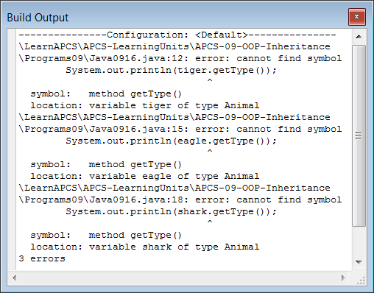
// Java0916.java // This program adds <getType> methods for each // one of the three <Animal> sub classes. // The program does not compile, because // <getType> is not an <Animal> method. public class Java0916 { public static void main(String args[]) { Animal tiger = new Cat("Tiger"); System.out.println(tiger.getType()); Animal eagle = new Bird("Eagle"); System.out.println(eagle.getType()); Animal shark = new Fish("Shark"); System.out.println(shark.getType()); } } class Animal { public Animal() { System.out.println( "Animal constructor called"); } } | class Cat extends Animal { protected String catType; public Cat(String ct) { catType = ct; } public String getType() { return catType; } } class Bird extends Animal { protected String birdType; public Bird(String bt) { birdType = bt; } public String getType() { return birdType; } } class Fish extends Animal { protected String fishType; public Fish(String ft) { fishType = ft; } public String getType() { return fishType; } }
Notes:
The next program Java0916.java, in figure 9.29, changes classes Cat, Bird and Fish, which now have a new getType method. The getType method has the same name and the same purpose, but the methods are specialized to return the value of the object's data attribute. Using the same class name is the culprit. Cat, Bird and Fish may extend Animal, but getType is not a re-definition, it is new-definition and Java cannot find this method anywhere in the Animal class.

Slide 30
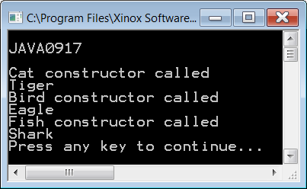
// Java0917.java // This program does compile, because each // object is a <Cat>, <Bird> or <Fish>, which // does have a <getType> method. public class Java0917 { public static void main(String args[]) { System.out.println("\nJAVA0917\n"); Cat tiger = new Cat("Tiger"); System.out.println(tiger.getType()); Bird eagle = new Bird("Eagle"); System.out.println(eagle.getType()); Fish shark = new Fish("Shark"); System.out.println(shark.getType()); } } | class Cat { protected String catType; public Cat(String ct) { System.out.println("Cat constructor called"); catType = ct; } public String getType() { return catType; } } class Bird { protected String birdType; public Bird(String bt) { System.out.println("Bird constructor called"); birdType = bt; } public String getType() { return birdType; } } class Fish { protected String fishType; public Fish(String ft) { System.out.println("Fish constructor called"); fishType = ft; } public String getType() { return fishType; } }
Notes:
Program Java0917.java, in figure 9.30, eliminates the error by creating three objects of three separate classes and not extending the Animal class. This is all very nice, but it makes you wonder why we started on this road of using the same class identifier with three different constructors. There also is the issue that the program in figure 9.30 does not use inheritance, which is the whole purpose of this chapter.

Slide 31
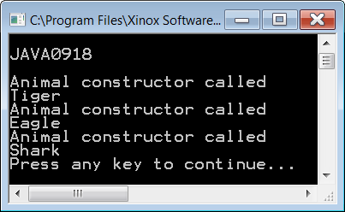
// Java0918.java // This program solves the problem of the // program Java0916.java. The <Animal> // superclass has a "fake" <getType> method // that is re-defined for each subclass. public class Java0918 { public static void main(String args[]) { System.out.println("\nJAVA0918\n"); Animal tiger = new Cat("Tiger"); System.out.println(tiger.getType()); Animal eagle = new Bird("Eagle"); System.out.println(eagle.getType()); Animal shark = new Fish("Shark"); System.out.println(shark.getType()); } } class Animal { public Animal() { System.out.println("Animal constructor called"); } public String getType() { return ""; } } | class Cat { protected String catType; public Cat(String ct) { catType = ct; } public String getType() { return catType; } } class Bird { protected String birdType; public Bird(String bt) { birdType = bt; } public String getType() { return birdType; } } class Fish { protected String fishType; public Fish(String ft) { fishType = ft; } public String getType() { return fishType; } }
Notes:
There is a reason for the inheritance and there is a reason to make every object an Animal object. Program, Java0918.java, in figure 9.31, goes back to the earlier program. Once again Cat, Bird and Fish extend Animal, but now the Animal class has a peculiar getType method that returns an empty string. The Animal class does not appear to be that practical either since it stores no values in any attributes.
We call Animal an umbrella class, since it covers multiple classes. In your school there are boys and girls; there are 9th, 10th, 11th and 12 graders; there are football players, cheerleaders and band members; there are many, many categories in your school and they all fall under the single umbrella of students.

Slide 32
Create 1 Super Class
with <= 3 Sub Classes
Create “fake” method in Super
Create real methods in subs
Superhero
Dinosaurs
Human Body
Stands
Pastries
Colors
Shapes
Pants
Games
Myths
Books
Notes:
This is a very significant concept that will be investigated in great detail in a future chapter titled Focus on OOP, Polymorphism. Right now you are seeing the programs in this section for two reasons. First, it sets the stage for the future polymorphism chapter. Second, you will see this type of code the GirdWorld Case Study. You need to understand that it is quite normal, and desirable, to declare multiple classes under one umbrella. For now the understanding part is not at all complete, but please accept that it is appropriate and used for polymorphism in Object Oriented Programming.

Slide 33
Summary
Corner Stones of OOP:
Encapsulation
Class Interaction
  Inheritance
Polymorphism
Notes:
With inheritance it is possible to use existing classes with all their available features, both methods and attributes. The existing class is called the superclass and the new class derived from the superclass is called the subclass. Inheritance involves an "is-a" relationship. This means that first and foremost every subclass "is-a" superclass. Geometry provides good examples, such as a square is-a rectangle. In Java the reserved word extends is used to indicate that a class declaration is a subclass of an existing superclass.
It is very important not to confuse inheritance with composition. A new class can be declared that includes existing components. A new class may have multiple members, which are existing classes. In such a case the new class demonstrates a "has-a" relationship, because it has certain other members. We can also say that the new class is composed of other components and hence the term composition. In Geometry we do not say a rectangle is-a lines, but we certainly can say a rectangle has lines.
This chapter also introduced the protected reserved word, which is frequently used with inheritance. Superclass attributes that are private cannot be accessed by a subclass. However, if a superclass attribute is declared protected it can be accessed by subclass methods, while simultaneously denying access by any other program areas outside the superclass and subclass.
The biggest benefit of inheritance is the ability to use program components that have already been created and tested. New and improved versions of existing components can be designed without starting from scratch. This improves program design efficiency as well as increase program reliability.
A subclass does not reinvent the wheel. You create a new class with new methods. Some methods have the same identifier as the superclass methods. In such a case you are re-defining existing methods. In some other cases there are completely new methods with new identifiers. In the second case you are newly-defining methods.
Careful attention must be paid to information that is passed to other constructors. With inheritance, information is passed from the subclass constructor to the superclass constructor with the reserved word super. The super statement must be the first statement in the subclass constructor.
The constructor of the superclass is always called before the constructor of the subclass. If no information is passed to the superclass constructor, then it is not necessary to include a call to super. Java will make this call automatically for you. If you do pass information to the superclass, you must use a call to super with the required information for the constructor passed as parameters. The call to super must be the first statement in the subclass constructor.

